Slide 1
Receiver and software for receiving HamTV DVB-S /S2
From 2014 to 2017
October 2017
Jean Pierre Courjaud F6DZP
Notes:
Hello Everybody,
I ‘m Jean Pierre F6DZP.
I will talk you about receivers and software that we can use for receiving HamTV.

Slide 2
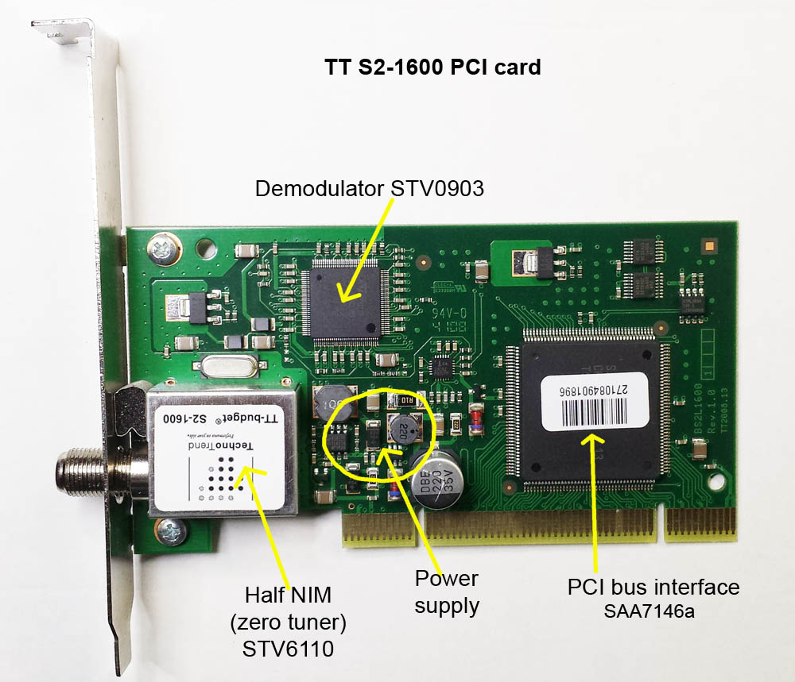
2014 solution :TT S2-1600
Notes:
Since 2014, for receiving HamTV, most of ground stations are using a PC and a PCI card : the TechnoTrend S2-1600.
We can see that we have
a zero tuner
a DVB-S demodulator
a TransportStream to PCI bus interface
A power supply

Slide 3
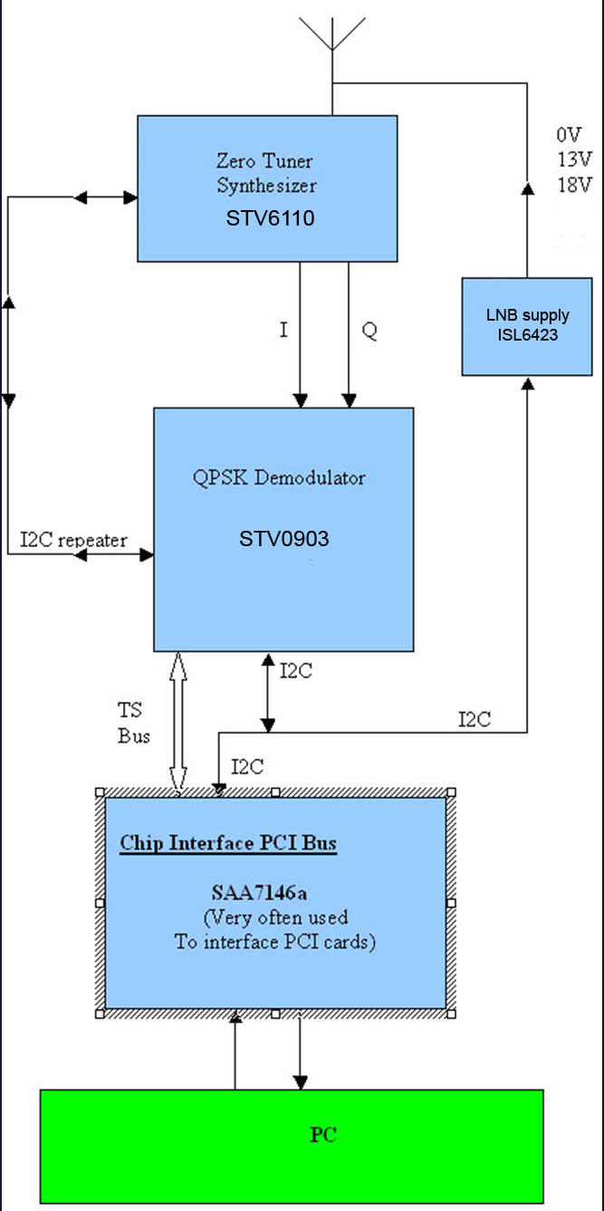
TT S2-1600 Internals
650MHz-2600MHz receiver
STV6110 processes RF signal
and gives I and Q signals
QPSK demodulator, STV0903, Processes I and Q signals
Transport Stream is transferred to the PC via the Multimedia processing chip, SAA7146a , connected to the PCI bus of the PC.
The software sends instructions to setup STV0903 via a I²C. The instructions are sent to the STV6110 synthesizer via an I²C repeater.
Notes:
If we look at the diagram, we can find
The zero tuner can receive from 650MHz up to 2600 MHz. It will extract the analogue IQ signals that will be sent to the demodulator
The demodulator locks on the good frequency and extract the Transport Stream (TS)
The transport stream is sent to the PC via the PCI bus interface

Slide 4
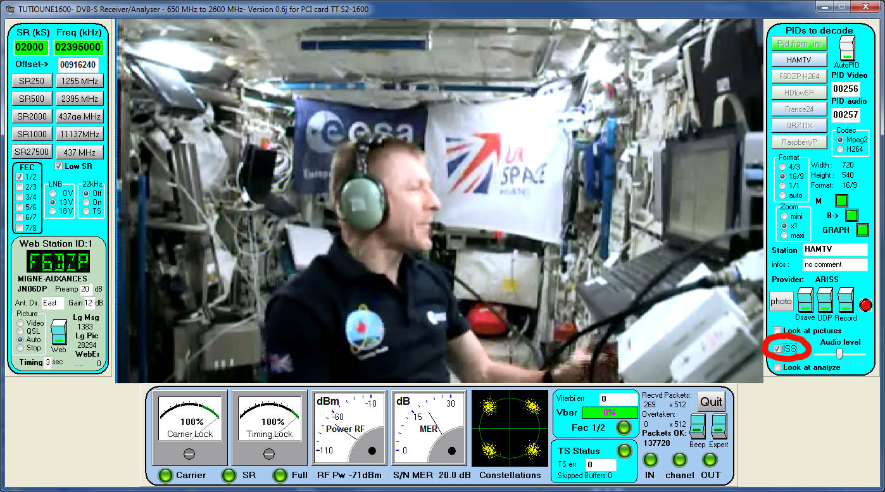
Software used: Tutioune1600
The « ISS » mode correct the DVB tables
Notes:
The software used with the S2-1600 is Tutioune1600.
It has been used to receive Tim Peak.

Slide 5
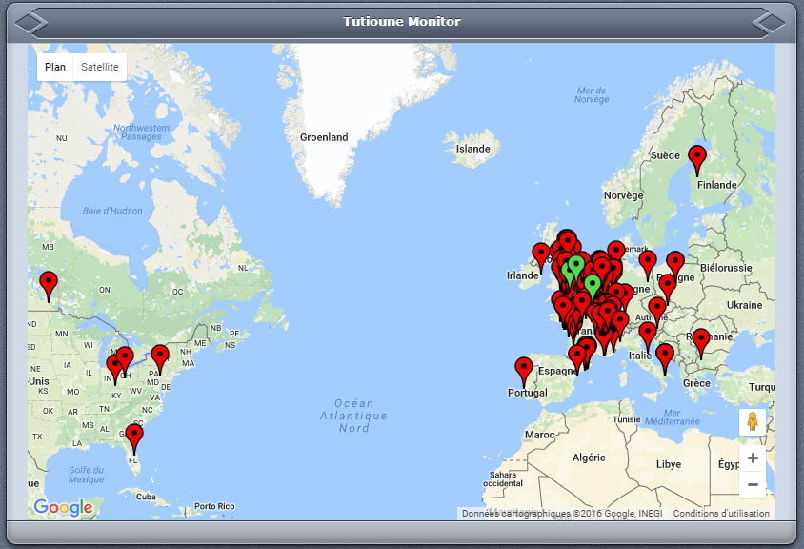
TiouneMonitor Map
Red icon = Tutioune is Offline
Green icon = Tutioune is Online, waiting a signal.
Green bouncing icon = Tutioune is Online and receiving a station
Notes:
Using the Tutioune Web button, we create an icon on the TiouneMonitor Map.

Slide 6
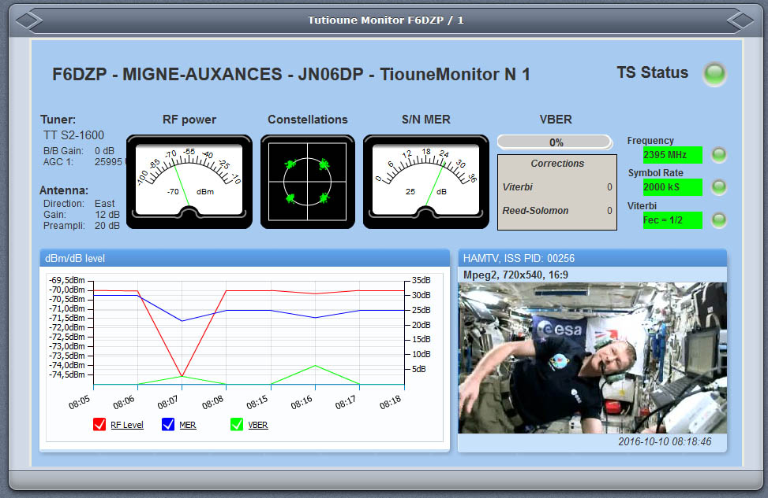
TiouneMonitor during an ARISS contact
Monitor your own transmissions as received remotely.
A unique and powerful tool. The most accurate way to give true, real time, signal reports.
Notes:
If we click on an icon we can see in real time what this station is receiving.
Here, this is my station receiving HamTV

Slide 7
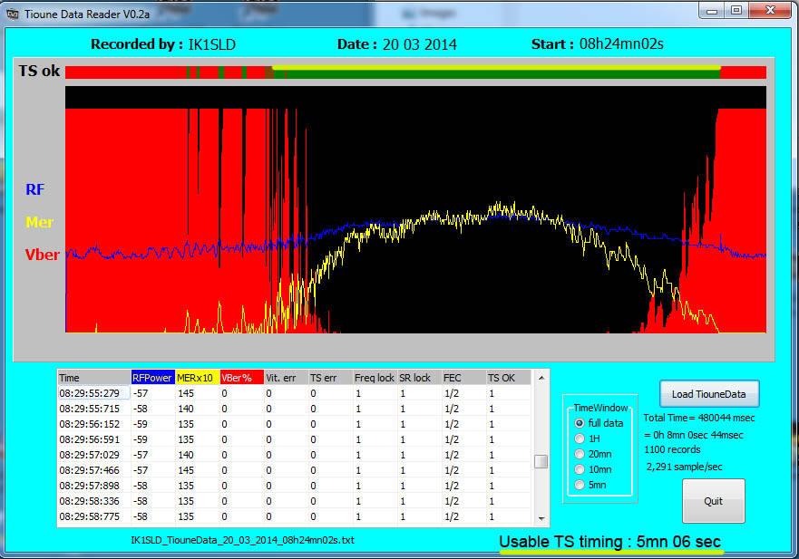
TiouneData Reader and HamTV reports
Notes:
Using the Tutioune Save Data button, we will save all the measuring data during a pass.
We will use the software « Tioune Data Reader » for observing how our tracking system has received the HamTV signal during a pass

Slide 8
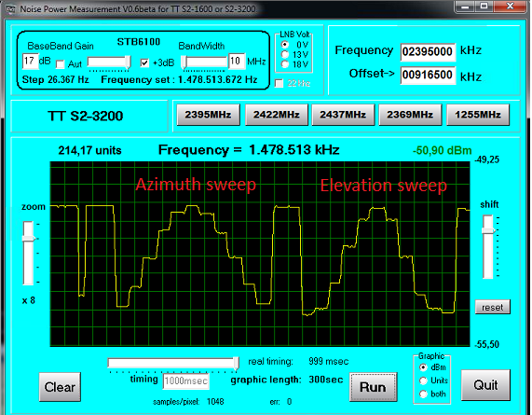
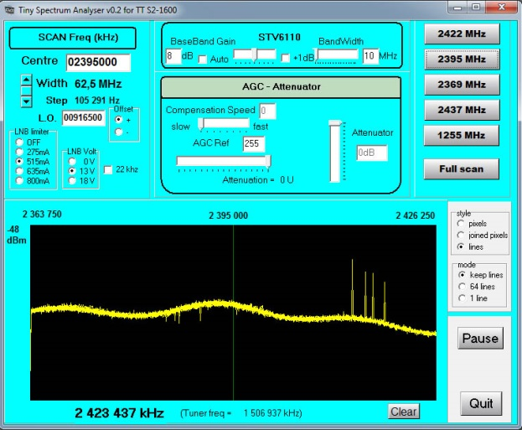
Tools to setup the antenna: tracking system, converter…
Noise Power Measurement (NPM)
Tiny spectrum Analyzer (TSA)
Notes:
2 others software tools have been developped to help us:
Noise power Measurement and Tiny spectrum Analyzer

Slide 9
NPM: tracking the sun
Notes:
Noise Power Measurement allows us to track the sun and measure the noise.
In this example, we use a specific version of Orbitron/whispDDE that send different commands to the rotors, giving them different offsets from minus 10° up to plus 10°…
If we obtain a beautiful pyramid, our tracking system is well set.

Slide 10

TSA : obervation of Wifi interferences
Notes:
Tiny Spectrum Analyzer can show us the exact signal that is receive by the tuner card.
We can see here Wifi interferences.
It has been usefull for testing the filter made by Kerry

Slide 11
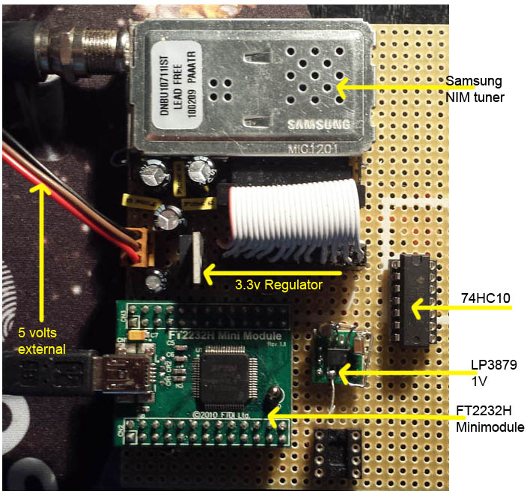
2015: Home brewed USB tuner
The TT S2-1600 card is no more available.
the MiniTiouner is born.
Only 3 parts:
1- NIM
2 - Parallel to USB module
3 - Power supply
Notes:
In 2015, Technotrend stoped producing the S2-1600
I have designed a new Tuner : the MiniTiouner

Slide 12
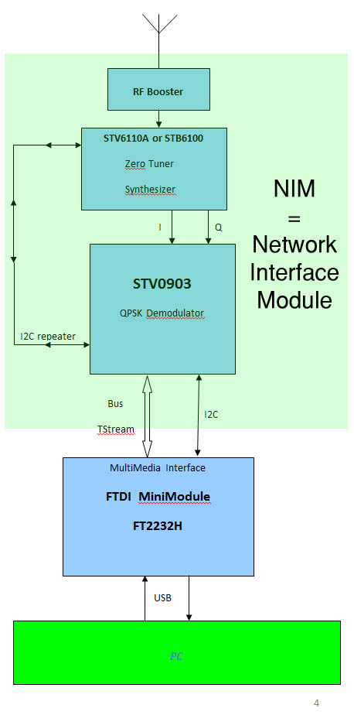
MiniTiouner Internals
650MHz-2600MHz receiver
STB6100 or STV6110 processes RF signal and gives analogue differential I and Q signals
QPSK demodulator, STV0903, Processes I and Q signals
Transport Stream is transferred to the PC via the FTDI Mini-Module FT2232H, connected to the USB input of the PC.
The software sends instructions to setup STV0903 via USB / I²C. The instructions are sent to the STB6100 or STV6110 synthesizer via an I²C repeater.
Notes:
Always the same process:
The zero tuner extract I and Q
The demodulator locks on the good frequency and SR and extract the TS
The Transport Stream is sent to the PC via the Parallel to USB interface

Slide 13
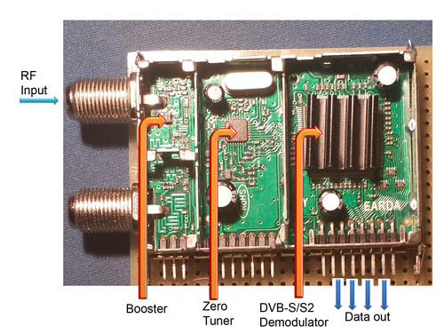
a NIM
Network Interface Module
Notes:
Inside a NIM we can find
The RF preamplifier
The zero tuner
The demodulator
It is very simple : we give RF signal, we get the Transport Stream.

Slide 14
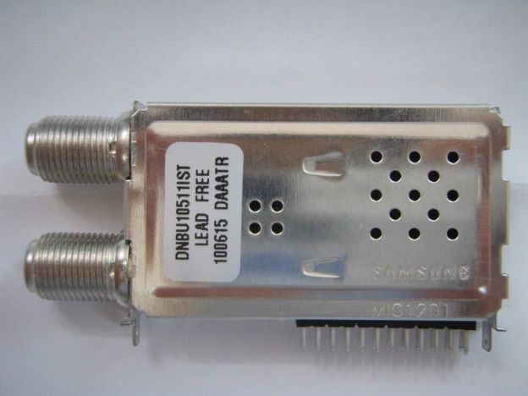
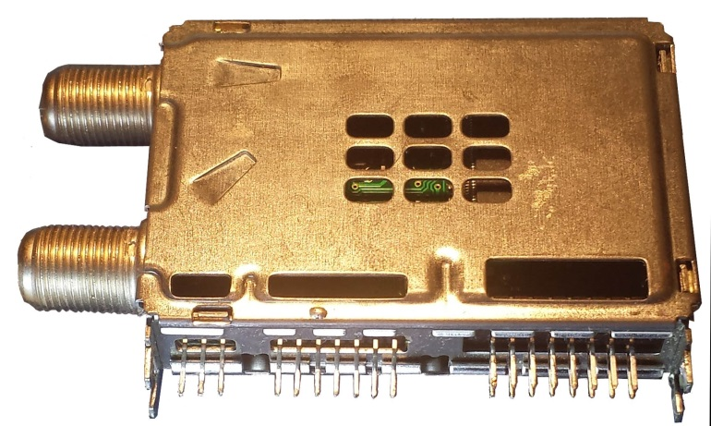
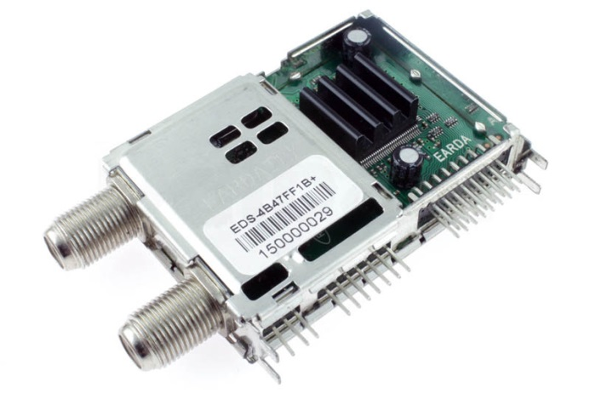
Which NIM must I use?
To be sure that it works well also at low SR, we must chose a NIM using a STV0903 as the demodulator.
In 2015, I have selected 3 kinds of NIM.
Samsung Sharp Eardatek
In 2016,I have added 2 new NIMs : LG and Serit with STV0913
Notes:
Ve can use different kind of NIM that we can find on Ebay or AliExpress

Slide 15
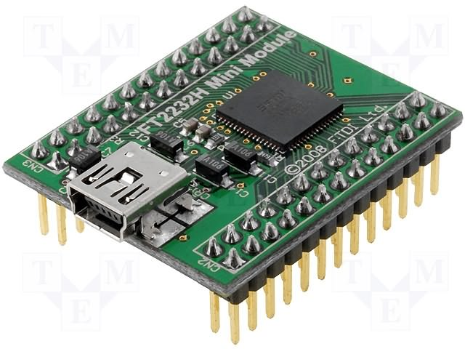
The parallel to USB interface: the FT2232H mini module
Notes:
We could use directly the FT2232 chip, but for an home brewed solution, the Minimodule is easier to solder.

Slide 16
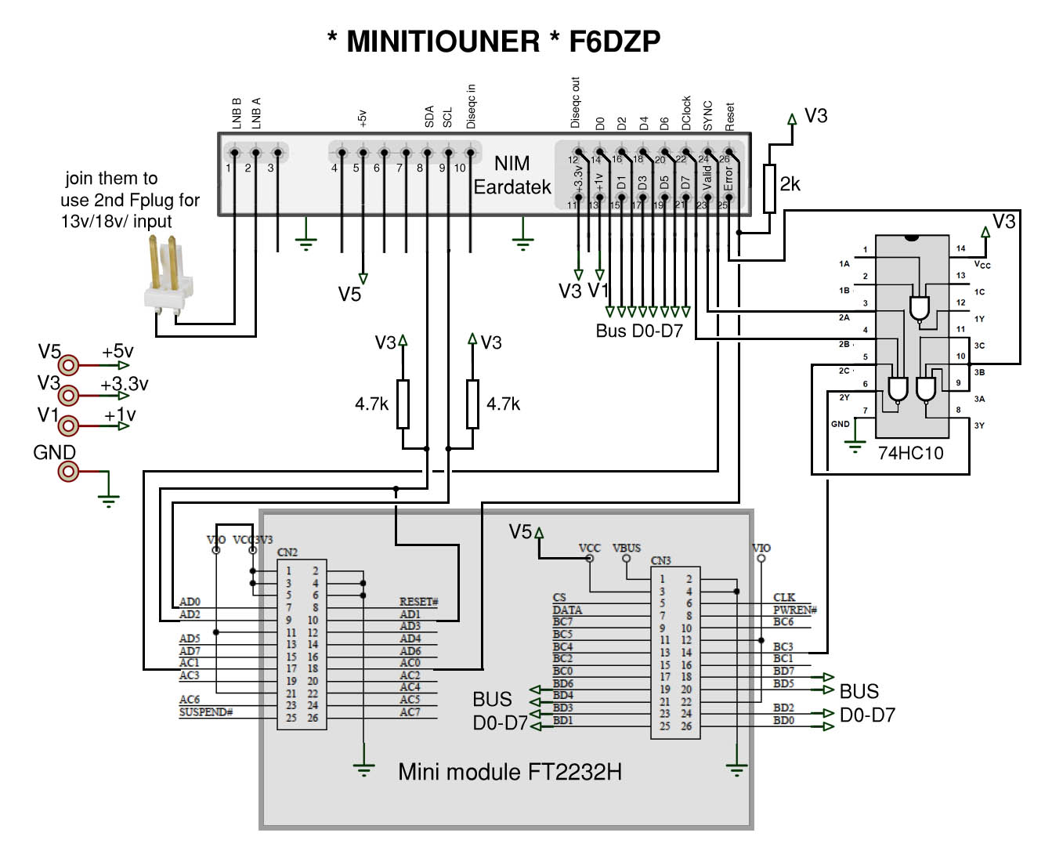
MiniTiouner: basic Schematic
Notes:
The schematic is simple
3 main components easy to solder:
- The NIM
- The minimodule
A TTL Nand
And the power supply

Slide 17
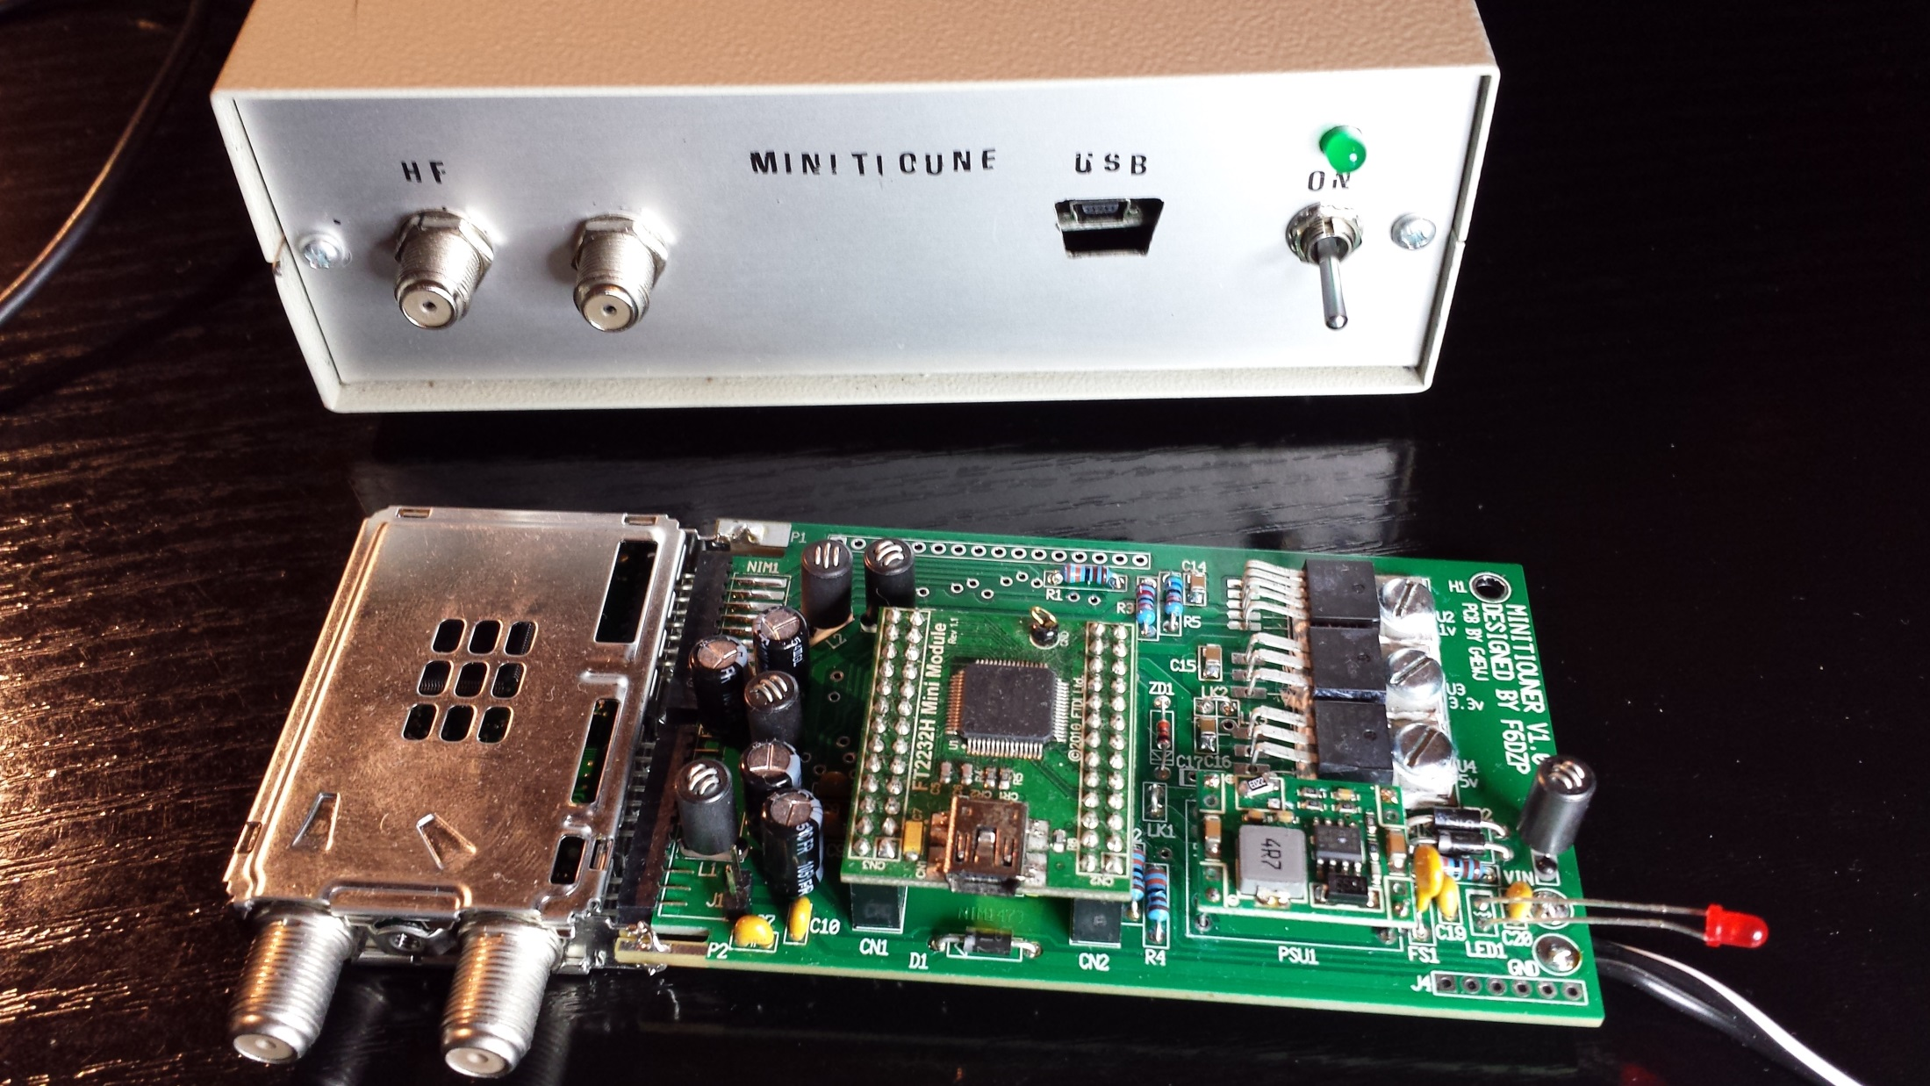
Minitiouner built from BATC kit
Notes:
Several PCB have been made in France, UK, Nederland, Japan ...
More than 300 MiniTiouners have been built all over the World
Kits or PCB can be found at the BATC shop.

Slide 18
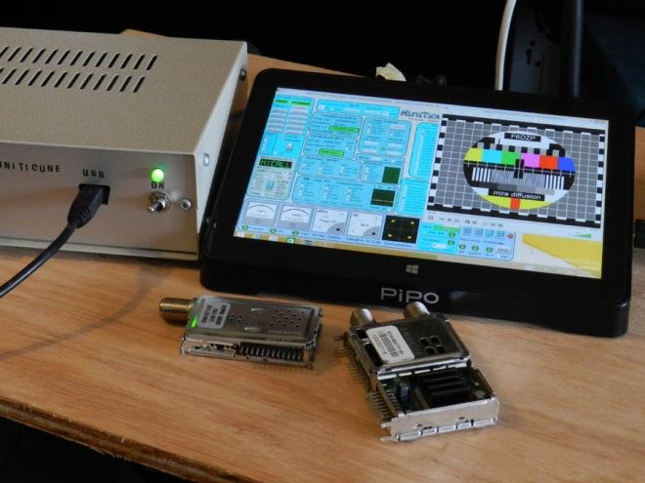
Using a Pipo X8
Notes:
We can also use a laptop or a PIPO X8 ( very small PC running Windows10 with an HD touchscreen, 12v, about 100$)

Slide 19
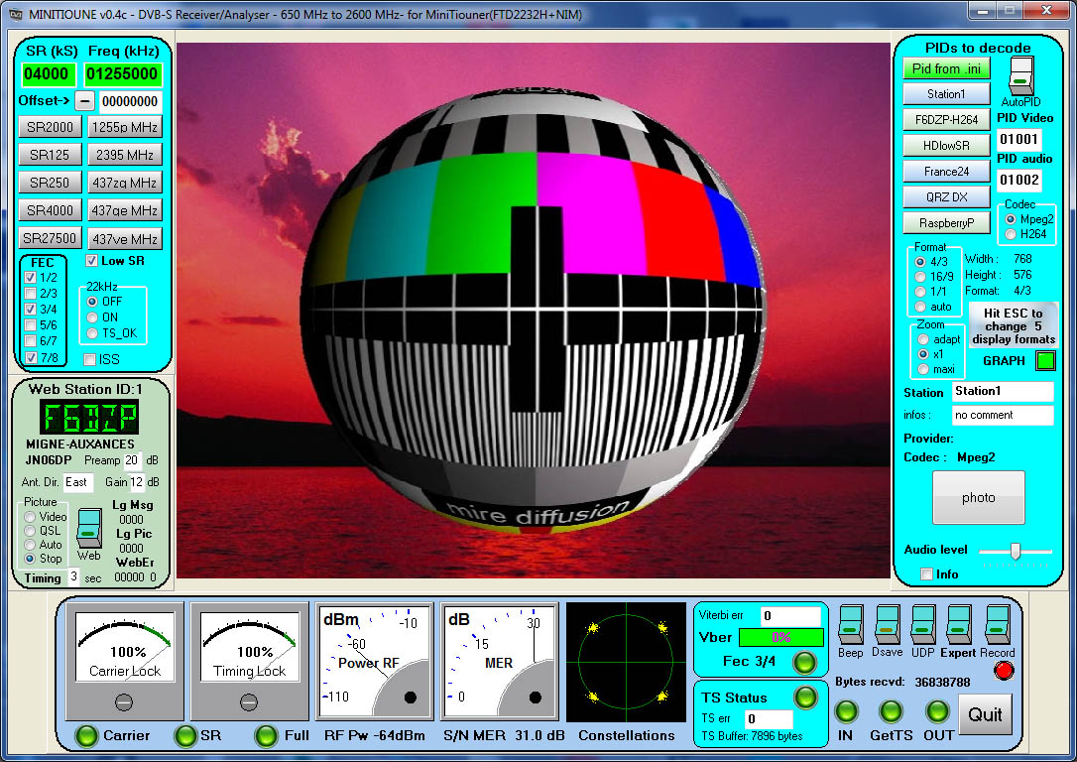
Minitioune v0.4c June 2016
Notes:
The last official version of Minitioune

Slide 20
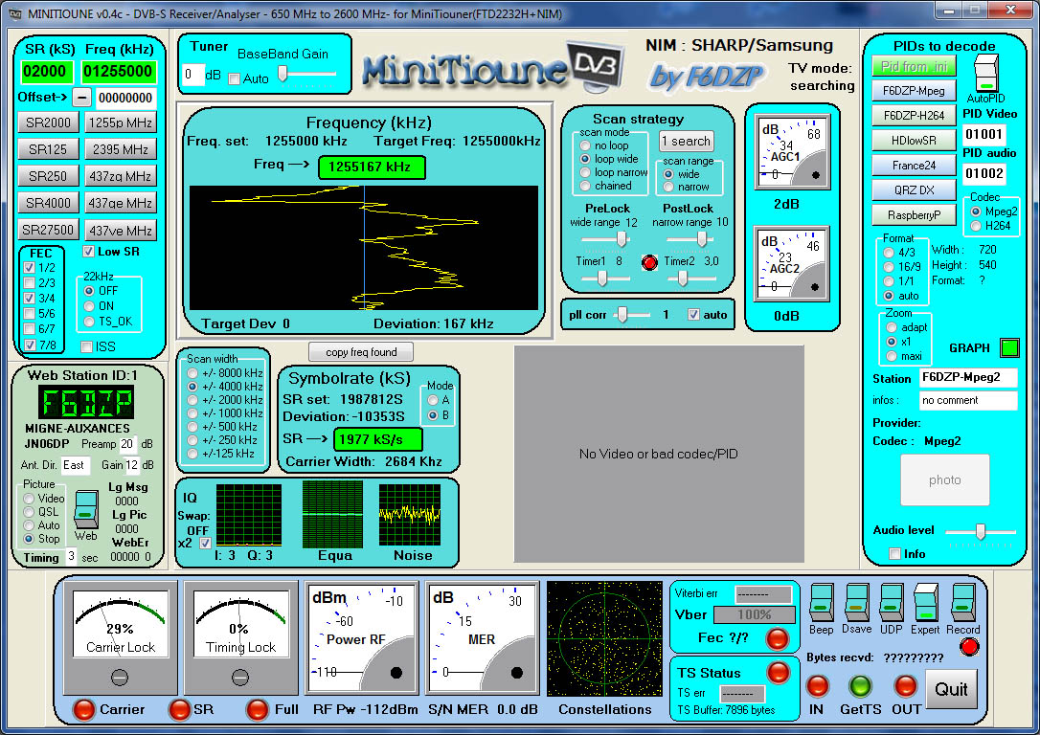
Minitioune v0.4c Expert mode
Notes:
The main changes can be found in the Expert Mode.
-

Slide 21
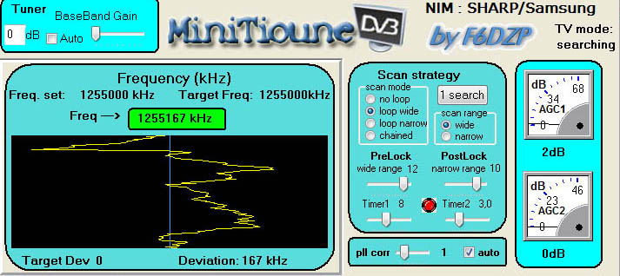
Minitioune v0.4c Expert mode
This new Expert mode is more simple and shows only what we need:
The scan strategy we use
The graphic that shows the derotator searching to lock the signal around the frequency asked
Notes:
This new Expert mode is more simple and shows only what we need:
The scan strategy we use
The graphic that shows the derotator searching to lock the signal around the frequency asked
The derotator is a double PLL loop that must lock on the true frequency and symbol rate. The Tuner is never on the frequency that we must lock, so here we can see the derotator searching under and above the frequency we have asked.

Slide 22
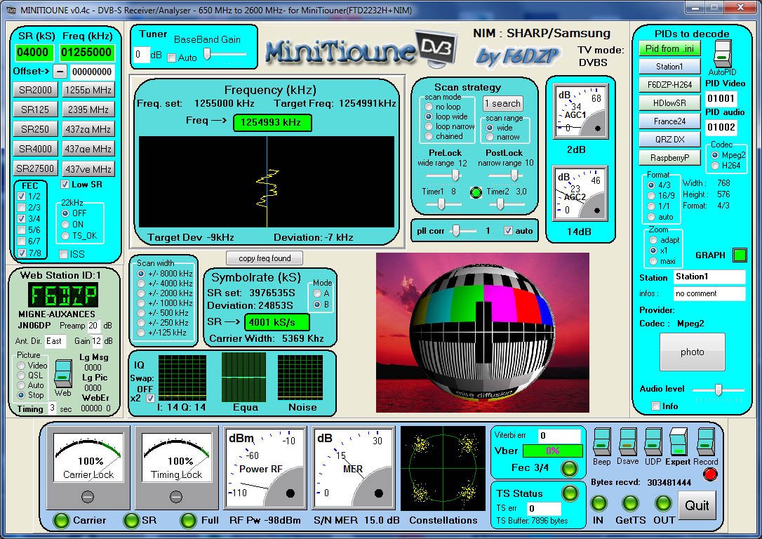
Minitioune v0.4c Expert mode
Notes:
Here we can see that now we are locked and the derotator deviation is now fixed. 7kHz
If we will be receiving HAmTV, we could see a diagonal showing us the deviation due to the Doppler effect ( about 120kHz during a pass)

Slide 23
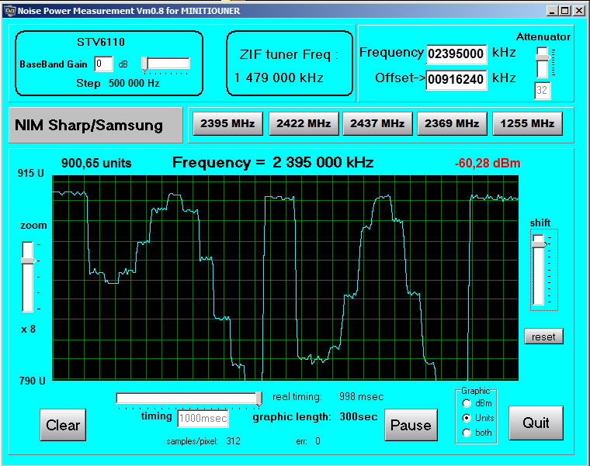
Noise Power Measurement
That helps for setting our tracking system, measuring the sun noise, using your MiniTiouner
Notes:
As more and more HamTV ground stations now use a Minitiouner
I have also developed the Noise Power Measurement software that can be used with a MiniTiouner.

Slide 24
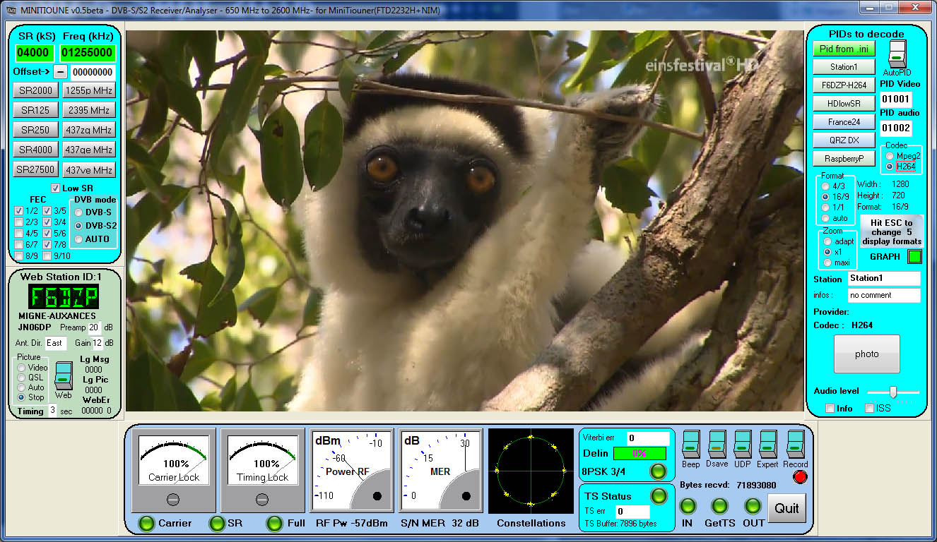
Sept 2016 : Minitioune v0.5
Notes:
Last version, in beta test, is the V0.5
Here we can see an HD video using only a Symbopl rate of 4000 kS/s
The modulation we are receiving is 8PSK

Slide 25
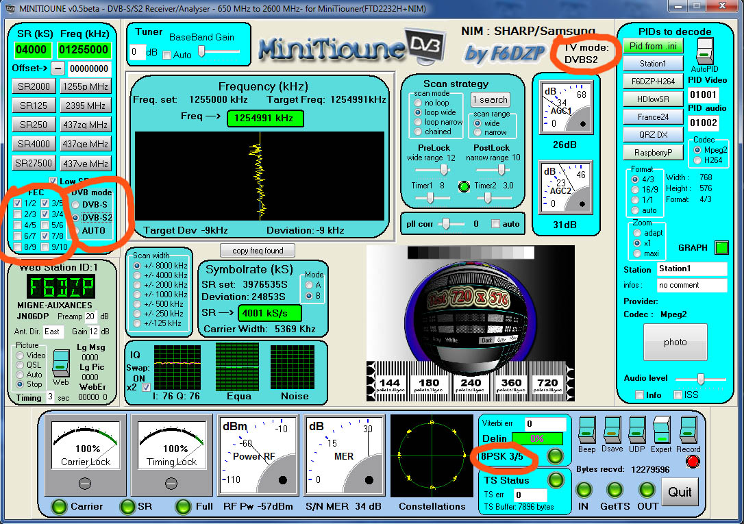
V.5 or .6=DVB-S and DVB-S2
Notes:
As we can see in Expert mode, we are receiving now DVB-S and DVB-S2

Slide 26
Minitioune v0.5 and up
=
DVB-S and DVB-S2
DVB-S2/QPSK gives us 2dB more gain in receiving sensitivity.
Today DVB-S2 is not used by HamTV , but it will be used by Es'HailSat in 2017 and (we hope) our future HamTV2 station or an uplink from ground.
Notes:
DVB-S2/QPSK gives us 2dB more gain in receiving sensitivity.
DVB-S2 will be useful in the future:
For Es’Hailsat satellite
For the future HamTV uplink from Ground Stations
For the future HamTV2 station

Slide 27
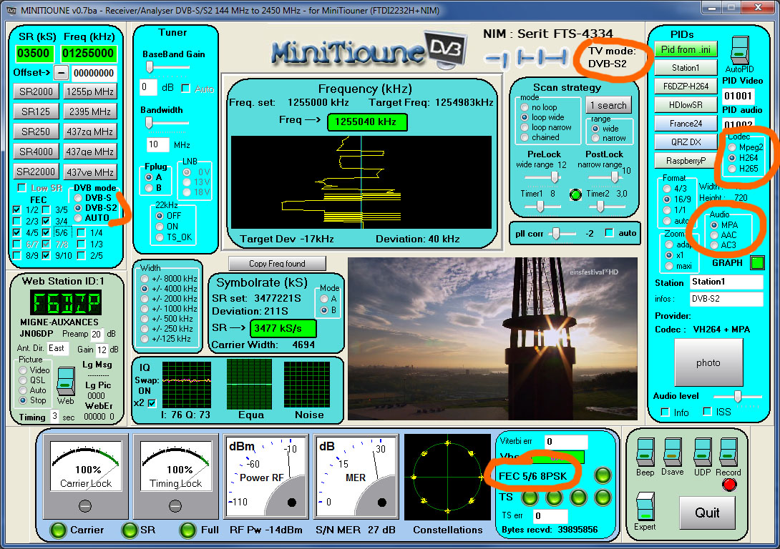
Minitioune v0.7 can work Mpeg2, H264 H265 video
Mpeg, AAC or AC3 audio
Notes:
DVB-S2/QPSK gives us 2dB more gain in receiving sensitivity.
DVB-S2 will be useful in the future:
For Es’Hailsat satellite
For the future HamTV uplink from Ground Stations
For the future HamTV2 station

Slide 28
2017
TS merger
&
MiniTiouner Pro
Notes:
And the next harware for 2017 will be the MiniTiounerPro.

Slide 29
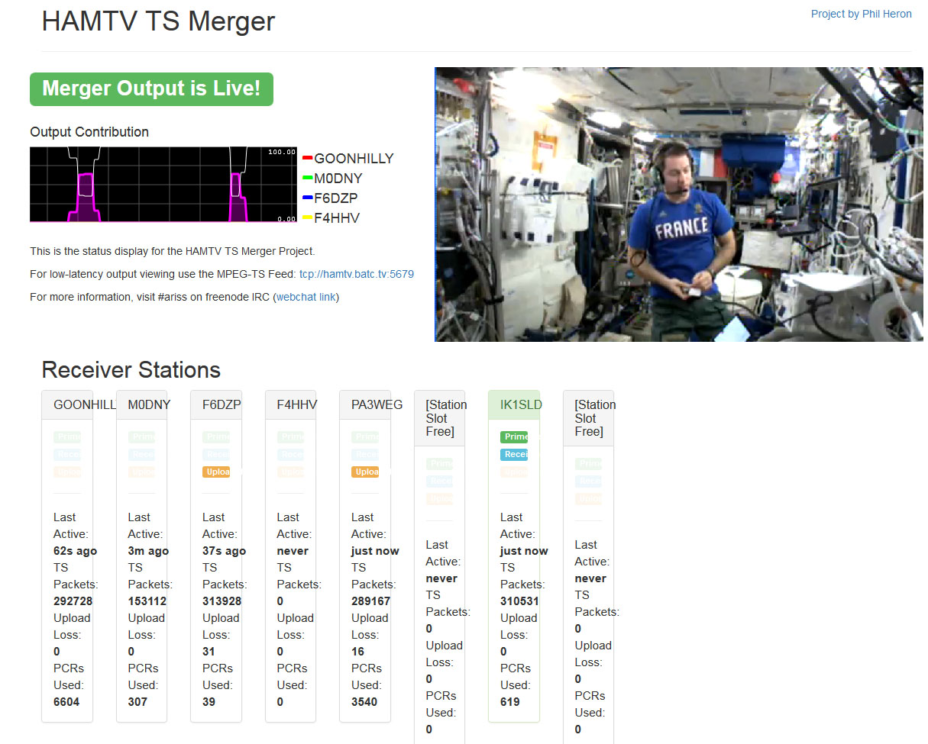
TS merger

Slide 30
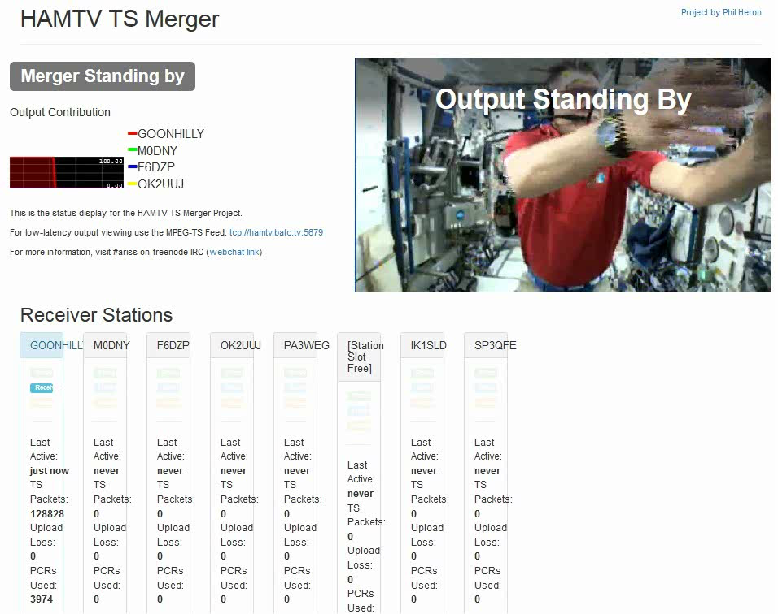

Slide 31
TS merger
Minitioune
Running on your PC
UDP
DVBpush
Internet
TS merger Server
BATC streaming Server

Slide 32
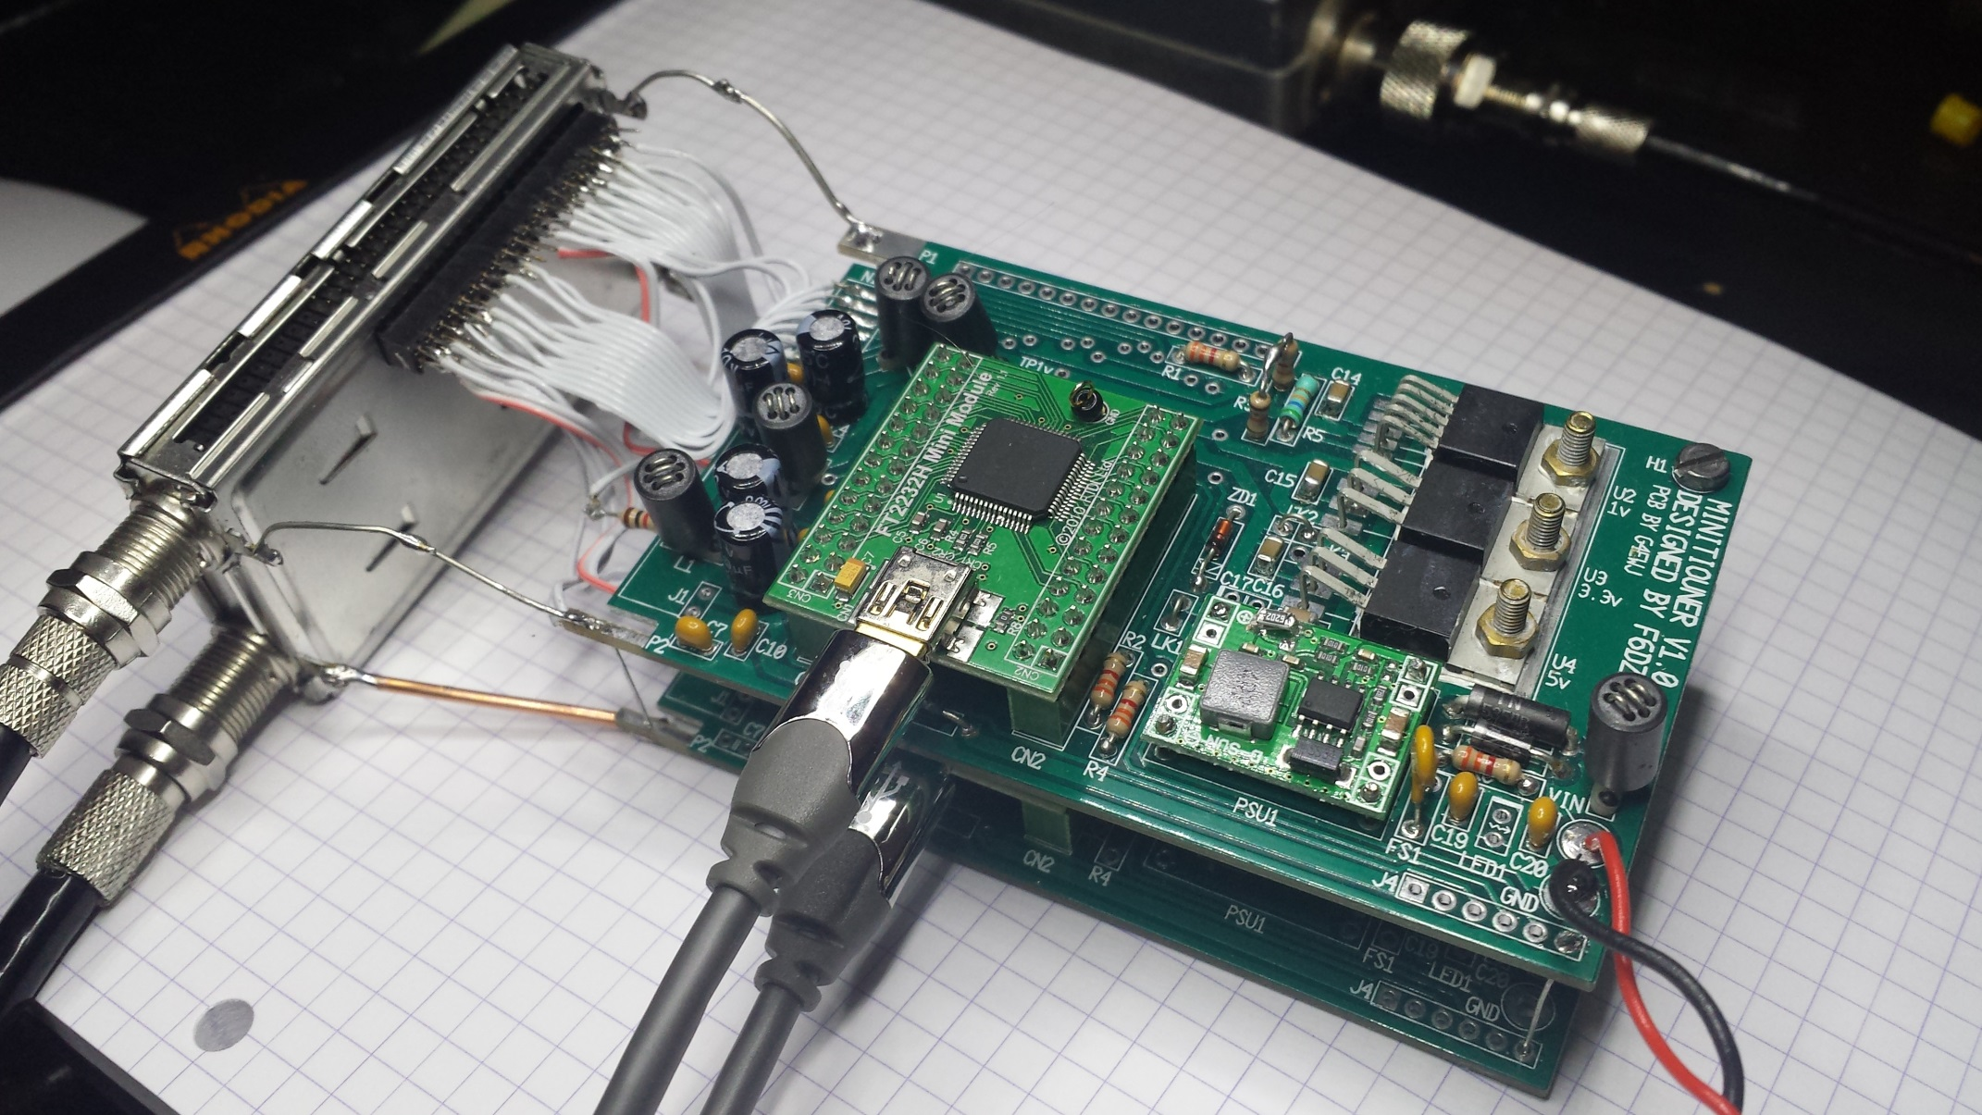
MiniTiouner Pro - prototype
Notes:
A prototype is already running

Slide 33
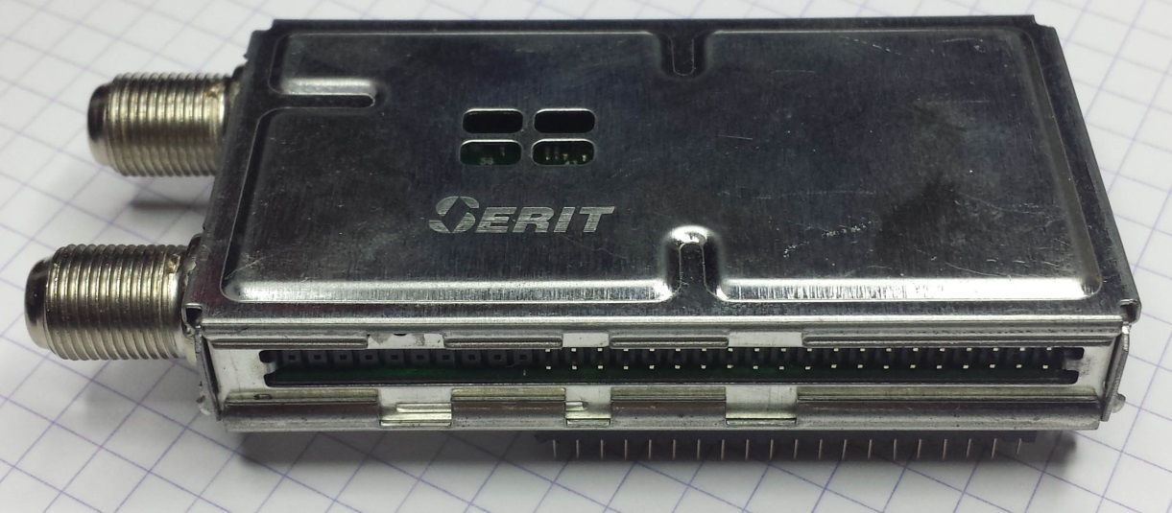
MiniTiouner Pro
Using a NIM Pro : Serit FTS-4335
  2 x RF inputs
  2 x ZIF tuners
  2 x DVB-S/S2 demodulators
  2 x TS parallel outputs
Notes:
We have RF inputs, 2 zero tuners and 2 demodulators that can work in parallel.
So we can get 2 transport streams

Slide 34
Dual tuner STV6120
Two independently programmable tuners
Input frequency range 250 MHz to 2150 MHz
➔tested working from 144MHz to 2450 MHz
Extremely low phase noise
Continuously variable gain: 0 to 65 dB
programmable gain on baseband amplifier: 0 to 16 dB
Programmable 5- to 36-MHz cut-off frequency => the lowest bandwidth filtered is 10MHz.
Notes:
The good news are:
We can receive from 144MHz up to 2450 MHz
The only upgrade we don’t have:
As the other solutions using a standard NIM, the lowest filtered bandwidth is only 10MHz
The only way to get a better filtered signal for low symbol rate would be to create a card without NIM, but only the chips with a filter between the zero tuner and the demodulator. (SuperTiouner project)
So we don’t have a SuperTiouner here, but only a MiniTiounerPro

Slide 35
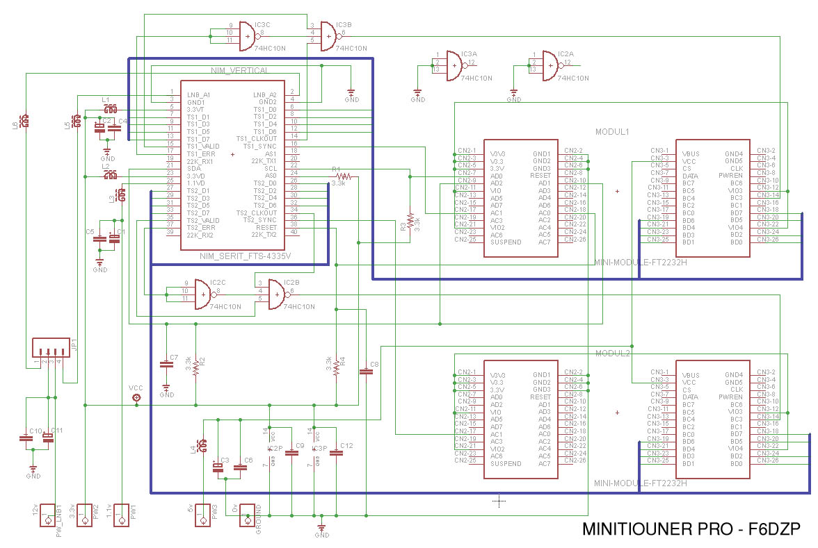
MiniTiouner-Pro schematic
We can use the same schematic as we have used for the MiniTiouner. We just need another FT2232H to output the 2nd TS via 2nd USB port.
Notes:
We can use the same schematic as we have used for the MiniTiouner.
(changing 1v supply by 1.1v)
And if we want to output at same time the 2nd TS via USB, we just need another FT2232H
Another option could be to output the second TS to a DVB parallel port

Slide 36
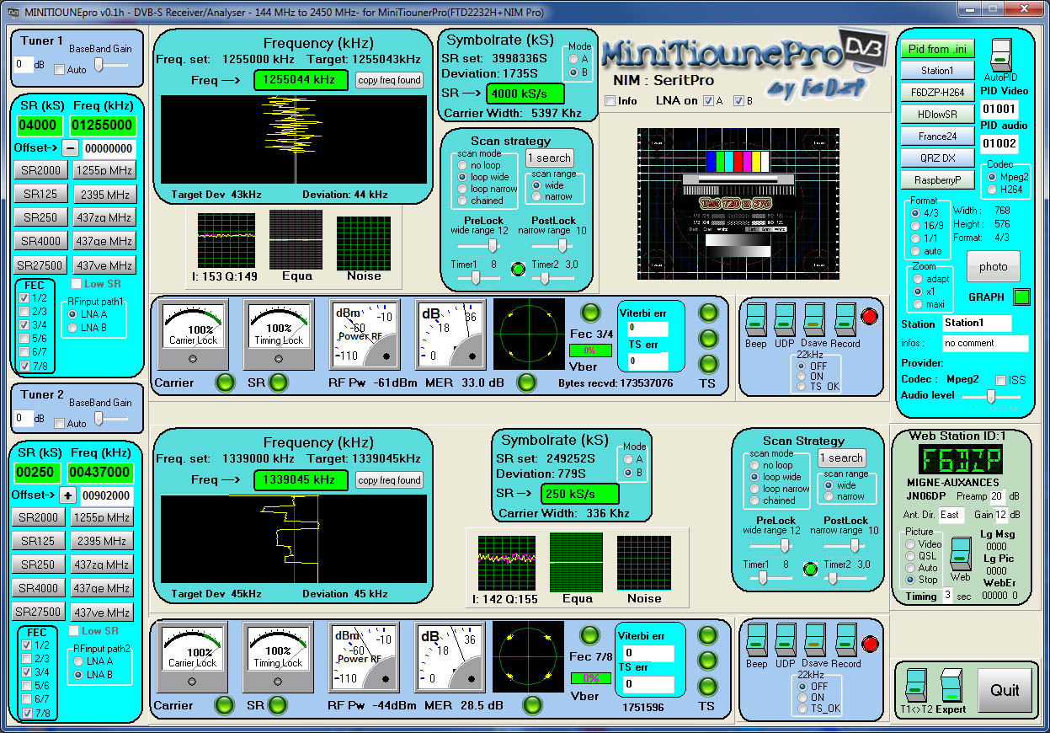
Minitioune Pro – 2 freq locked
Notes:
The new software is already developed.
His name is Minitioune Pro.
As we can see , we can lock at same time on 2 different frequencies ( here one on the 23cm band and one on the 70 cm band)

Slide 37
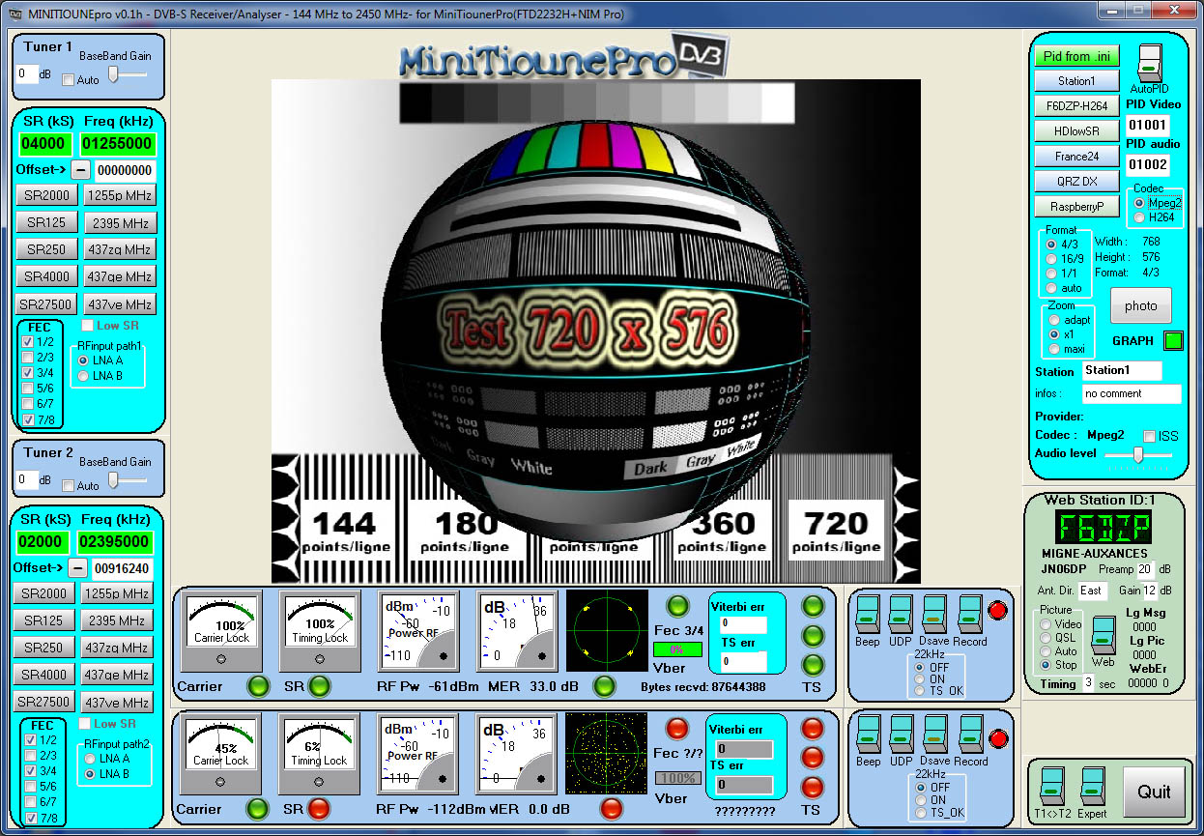
Minitioune Pro - TS1 display
Notes:
We can show the video from Transport Stream1 or from Transport Stream2
Using the switch at the bottom right

Slide 38
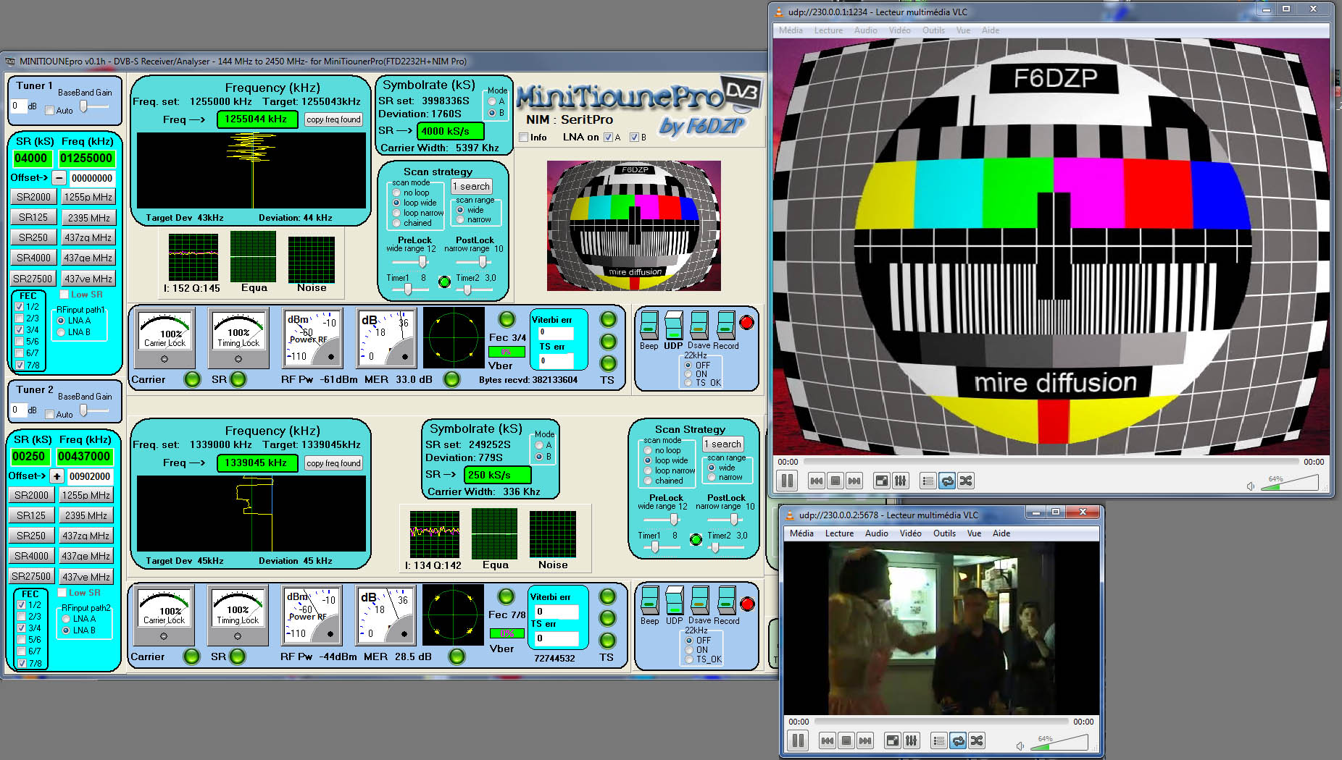
Minitioune Pro
Using 2 VLC
Notes:
We can also see at same time both video if we use 2 VLC.
Next version will be able to receive also DVB-S2

Slide 39
MiniTiouner-Pro - availability
MiniTiouner-Pro seems to be a good solution for the future
It can be used for many applications:
DATV DVB-S
DATV DVB-S2 QPSK- 8PSK – 16APSK and 32 APSK
Narrow band DATV (down to 75 kS/s)
Receiving HamTV
Receiving broadcast satellite DVB-S or DVB-S2
Different solutions are offered:
> a little adapter for the MiniTiouner pcb that exists
> a new kit or PCB.
> a MiniTiouner-Pro fully assembled and tested, as proposed by the REF.
Notes:
The MiniTiouner will be the new solution for 2017
We have now to think of the different ways it can be offered:
As an upgrade of a MiniTiouner ( the BATC ic preparing a little pcb to adapt the new NIM to the MiniTiouner pcb that already exist)
As a new pcb or kit
As a MiniTiouner-Pro fully assembled and tested as proposed by Art .

Slide 40
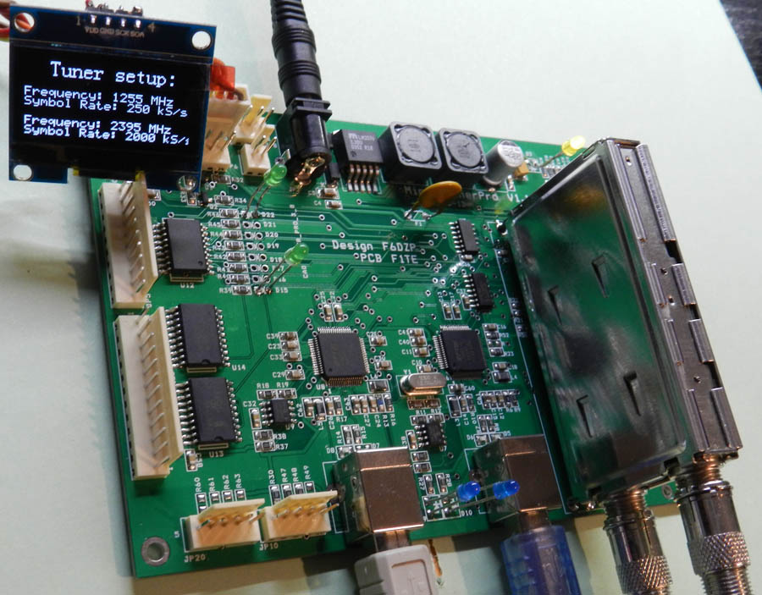
MiniTiouner-Pro - availability
a MiniTiouner-Pro fully assembled and tested, as proposed by the REF for 99 euros.
Notes:
The MiniTiouner will be the new solution for 2017
We have now to think of the different ways it can be offered:
As an upgrade of a MiniTiouner ( the BATC ic preparing a little pcb to adapt the new NIM to the MiniTiouner pcb that already exist)
As a new pcb or kit
As a MiniTiouner-Pro fully assembled and tested as proposed by Art .

Slide 41
Conclusion
The Minitiouner / MiniTiouner-Pro project offer us a USB DVB-S/S2 tuner that can receive from SR 75 kS/s up to 45000 kS/s.
Pipo X8/X9 + Minitiouner = a mobile solution
Narrow Bandwidth DATV is now possible for DX
A good solution for receiving HamTV.
NIM, pcb and others components are available at the BATC shop
A fully assembled and tested MiniTiounerPro at the REF shop.
All information on www.vivadatv.org Forum
You can also look at the BATC forum :
http://www.batc.org.uk/forum/
Notes:
The Minitiouner / MiniTiouner-Pro project offer us a USB DVB-S/S2 tuner that can receive from SR 120 kS/s up to 45000 kS/s.
NIM, pcb and others components are available at the BATC shop
Pipo X8/X9 + Minitiouner = a mobile solution
Narrow Bandwidth DATV is now possible for DX
A fully assembled and tested MiniTiounerPro in 2017
A good solution for receiving HamTV.

Slide 42
And now, what are our choices for HamTV2 ?

Slide 43
Thank you for your attention

